Slide 1
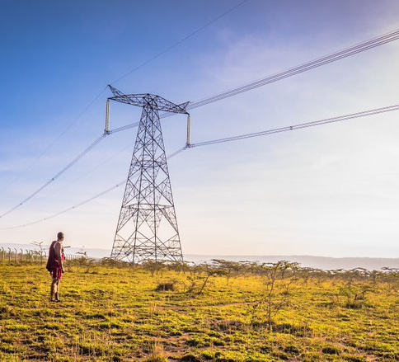
SOLAR ENERGY SYSTEMS
By
Bentlay Nango
Electrical Engineer – KETRACO

Slide 2
SOLAR ENERGY SYSTEMS
“The amount of sunlight that strikes the Earth’s surface in an hour and a half is enough to handle the entire world’s energy consumption for a full year”

Slide 3
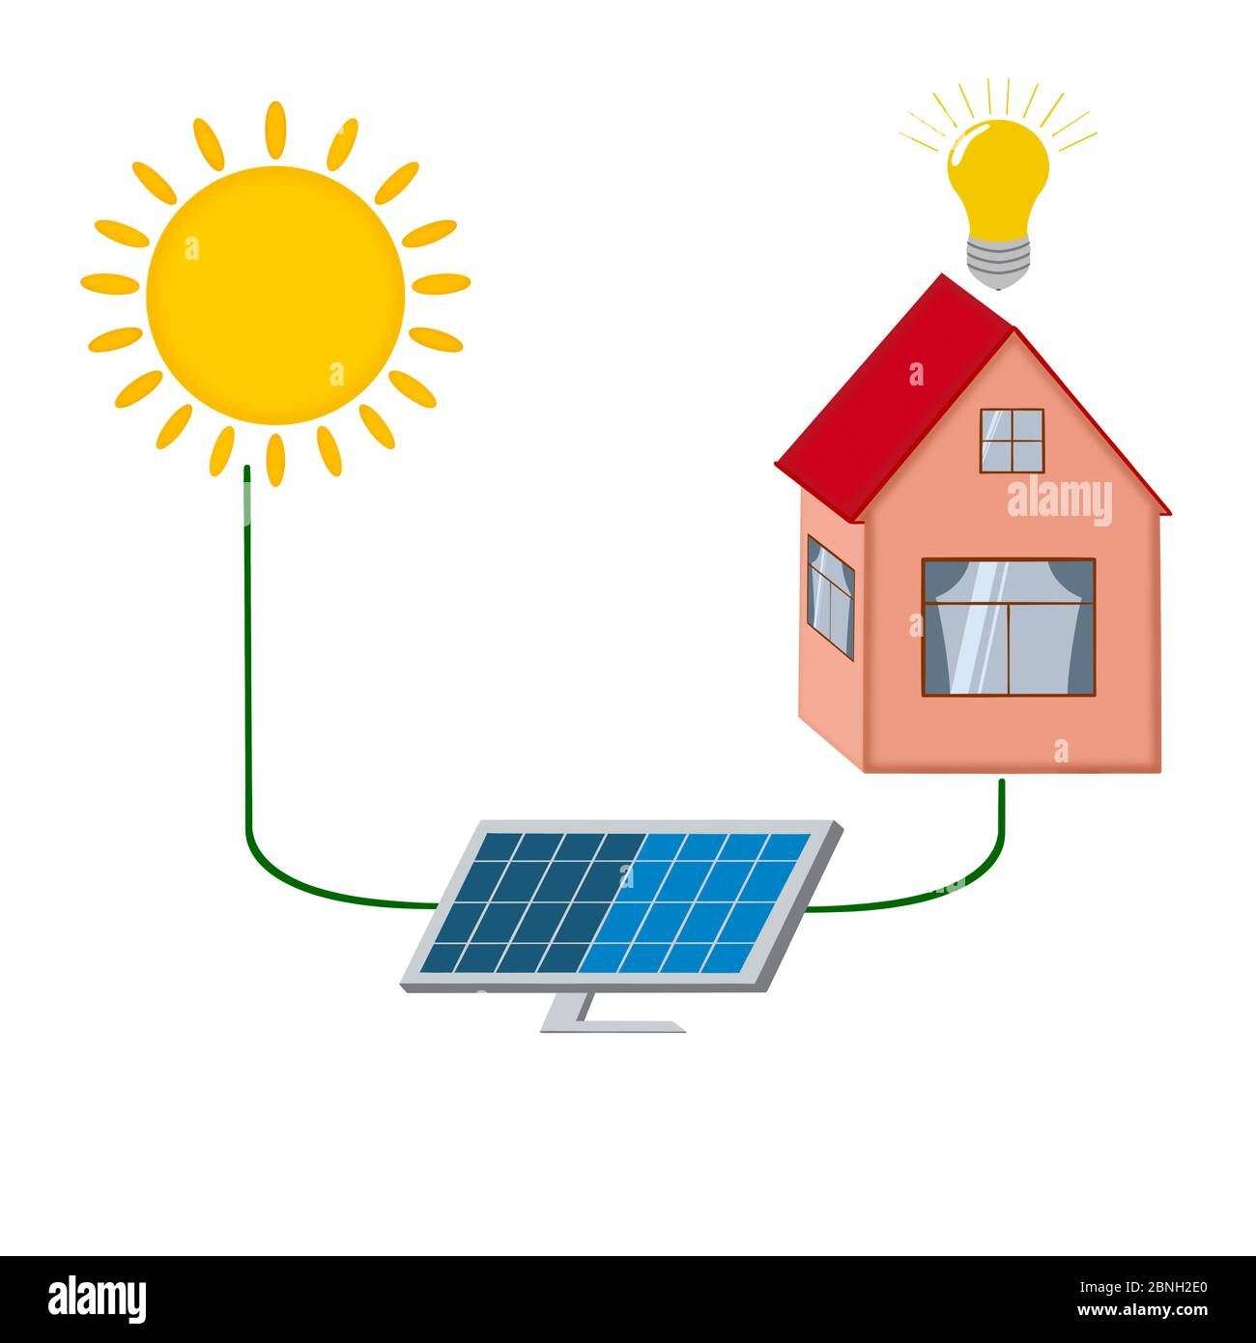
SOLAR ENERGY SYSTEMS SUB ITEMS
Categories
Types of Solar Power System
Basic Components
Why Solar Energy System
Sample Work
Demerits & Disclaimer

Slide 4
SOLAR ENERGY CATEGORIES
Solar Water Heating System
Solar Power & Lighting

Slide 5
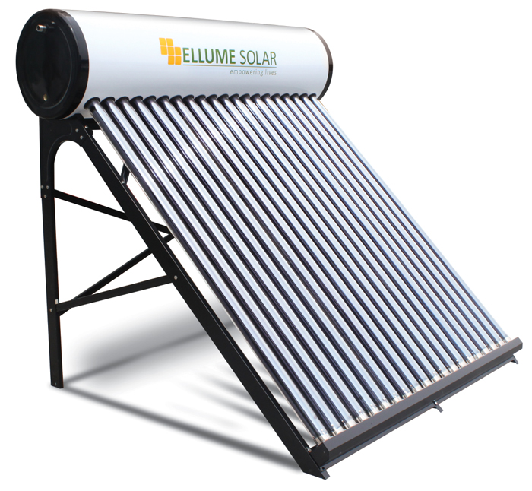
SOLAR WATER HEATING SYSTEM

Slide 6
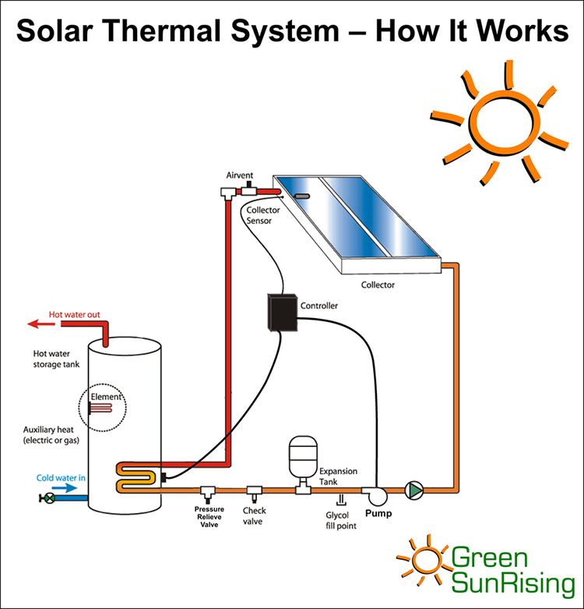
SOLAR WATER HEATING SYSTEM

Slide 7
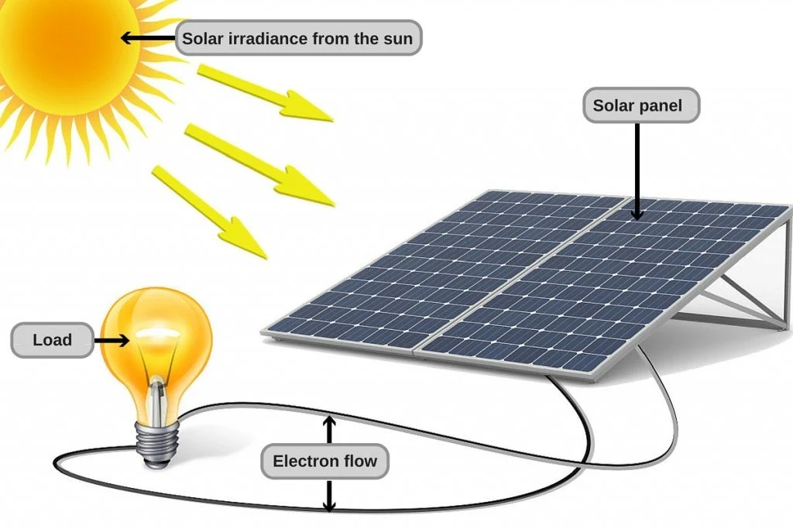
SOLAR POWER & LIGHTING

Slide 8
SOLAR POWER & LIGHTING TYPES
Off-Grid/ Standalone
Grid-tied/ Integrated/ On-Grid

Slide 9
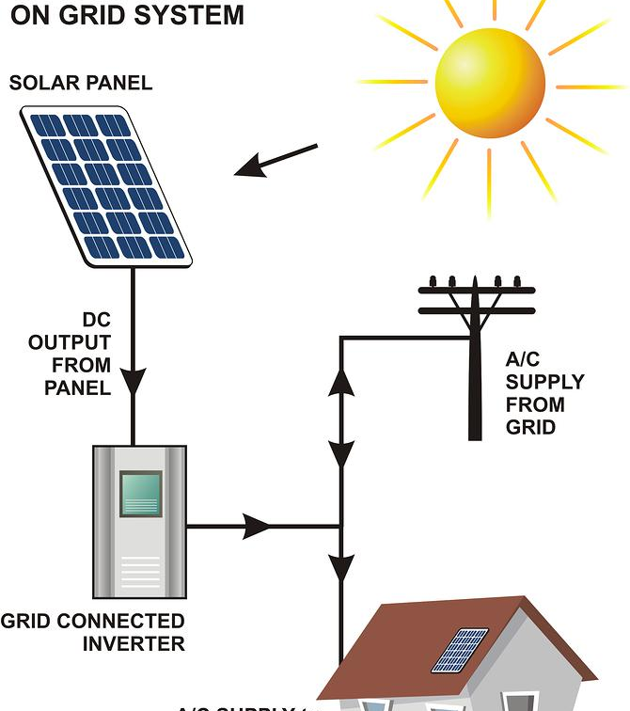
GRID-TIED EXAMPLE

Slide 10
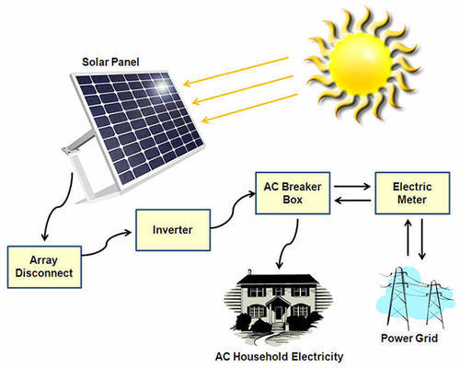
KEY COMPONENTS

Slide 11
WHY SOLAR ENERGY
Improved Efficiency
Lower Bills
Environment Friendly
Employment (Self – EPRA License/ NITA/UON or Hired )
Research – Energy storage

Slide 12
SAMPLE PROJECT – 50kW system
Assumptions:
Indoor Lighting Load – 2376W
Outdoor Lighting Load – 13840W
Peak Load – 16216W
Duration of operation for both indoor and outdoor lights per day – 10 hours
Days of Autonomy – 1
Battery Loss Factor – 0.85
Nominal Battery Voltage – 48V
Depth of Discharge (up to 40%) – 0.6 for lead acid battery
Lowest Temperature battery bank may experience – 16⁰C
Solar Panel Generation Factor for the Region – 4.16

Slide 13
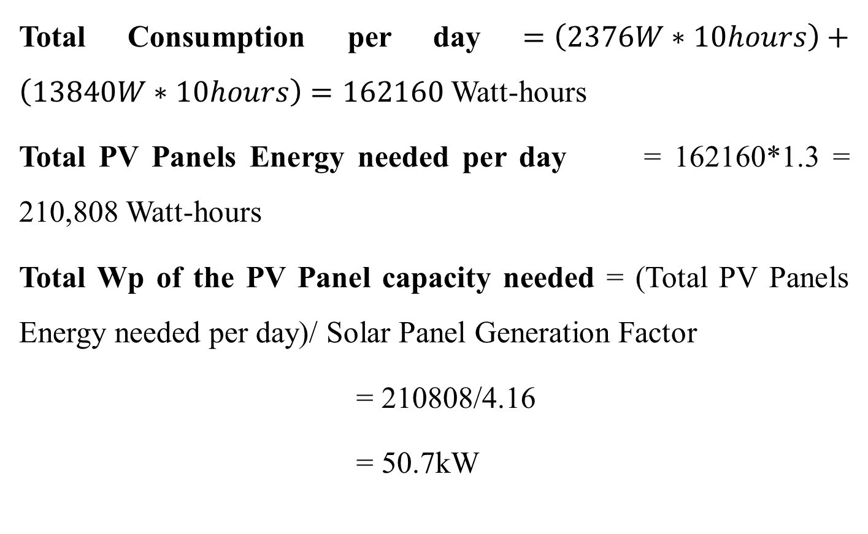
SAMPLE PROJECT – 50kW system Cont’d
Total Consumption per day $=\left(2376W∗10hours\right)+\left(13840W∗10hours\right)=162160$ Watt-hours
Total PV Panels Energy needed per day = 162160*1.3 = 210,808 Watt-hours
Total Wp of the PV Panel capacity needed = (Total PV Panels Energy needed per day)/ Solar Panel Generation Factor
= 210808/4.16
= 50.7kW

Slide 14
SAMPLE PROJECT – 50kW system Cont’d
Assuming Monocrystalline SunPower PV module with:
Pm = 400 Wp
Vm = 72.9 Vdc
Imp = 5.49 A
Isc = 5.74 A
Efficiency = 18.5%
Dimensions = 2067mm X 1046mm X 54mm
Weight = 22kg

Slide 15
SAMPLE PROJECT – 50kW system Cont’d
No of Panels Needed: = (Total Wp of the PV Panel capacity needed)/ Wp rating of the selected PV module
= 50.7kWp/ 400Wp
= 126.68 = 127 modules
Inverter size: = Peak load of indoor & outdoor lights * 1.5
= (2376+13840) * 1.5 = 24324 = 24kW
Hence a 30kW inverter suffices.

Slide 16
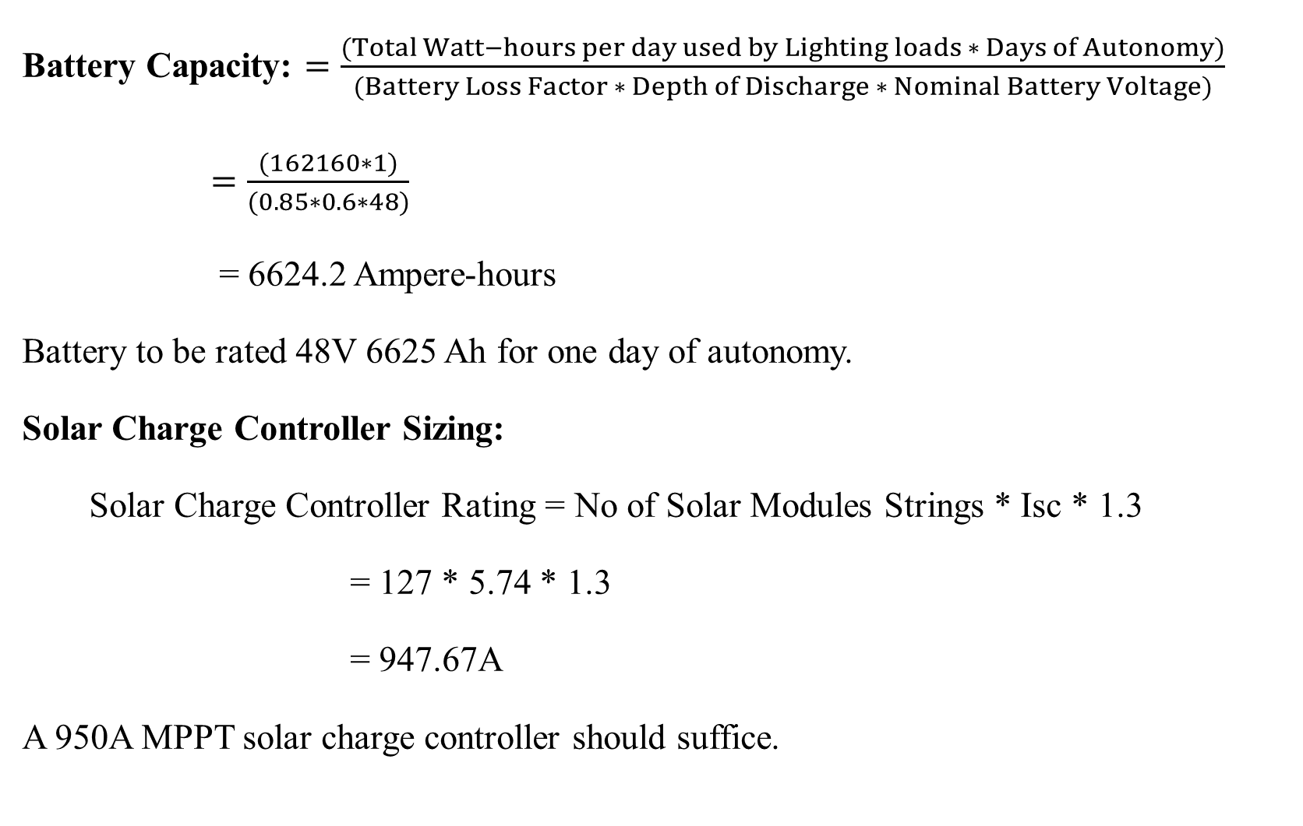
SAMPLE PROJECT – 50kW system Cont’d
Battery Capacity: $=\frac{(Total Watt−hours per day used by Lighting loads ∗ Days of Autonomy)}{(Battery Loss Factor ∗ Depth of Discharge ∗ Nominal Battery Voltage)}$
$=\frac{(162160∗1)}{(0.85∗0.6∗48)}$
= 6624.2 Ampere-hours
Battery to be rated 48V 6625 Ah for one day of autonomy.
Solar Charge Controller Sizing:
Solar Charge Controller Rating = No of Solar Modules Strings * Isc * 1.3
= 127 * 5.74 * 1.3
= 947.67A
A 950A MPPT solar charge controller should suffice.

Slide 17
SOLAR ENERGY SYSTEMS DISCLAIMER
Site Preparation
Shade Analysis
Sun hours & Irradiation Levels (Radiance) – Pyranometer (W/m2)
Tilt Angle (inclinometer)
Cost & Savings
Energy storage systems & maintenance costs

Slide 18
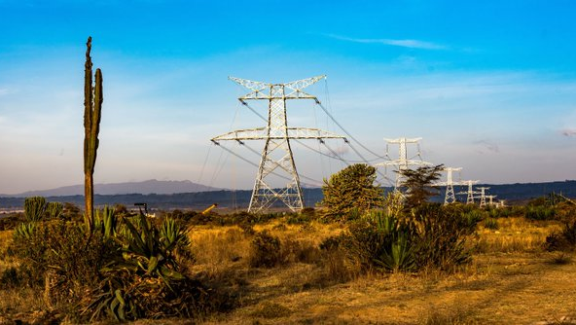
THE END

